Slide 1
Forecasting Demand for National Research Supercomputing
Australian Academy of Science
Yusuf Kurnia Romadhon

Slide 2
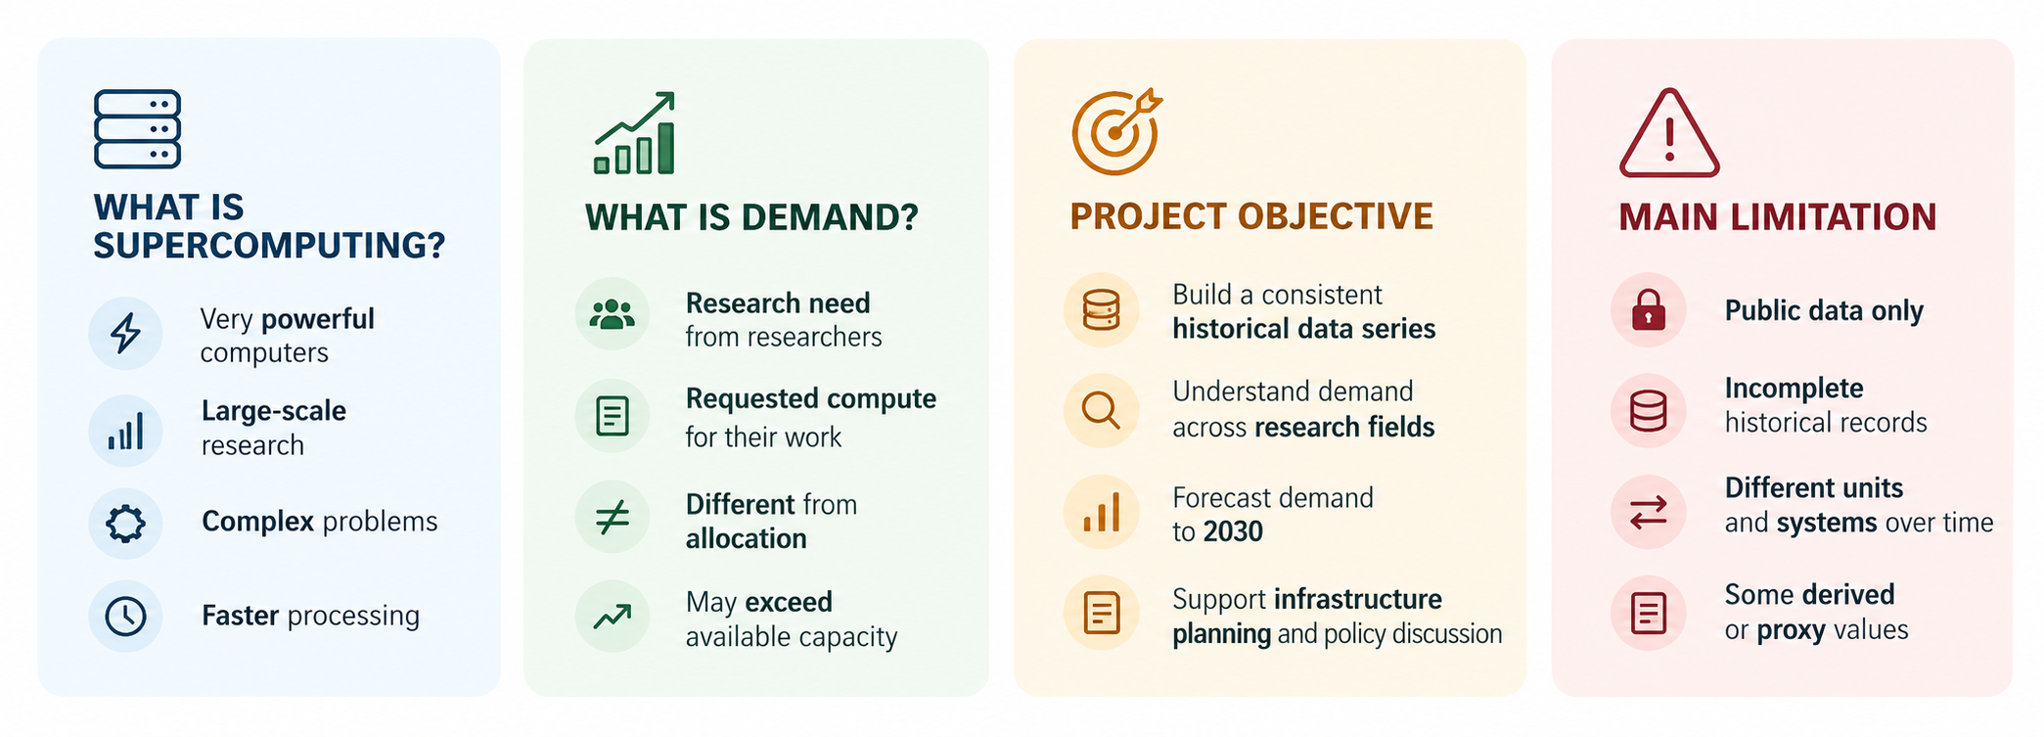
Project Introduction

Slide 3
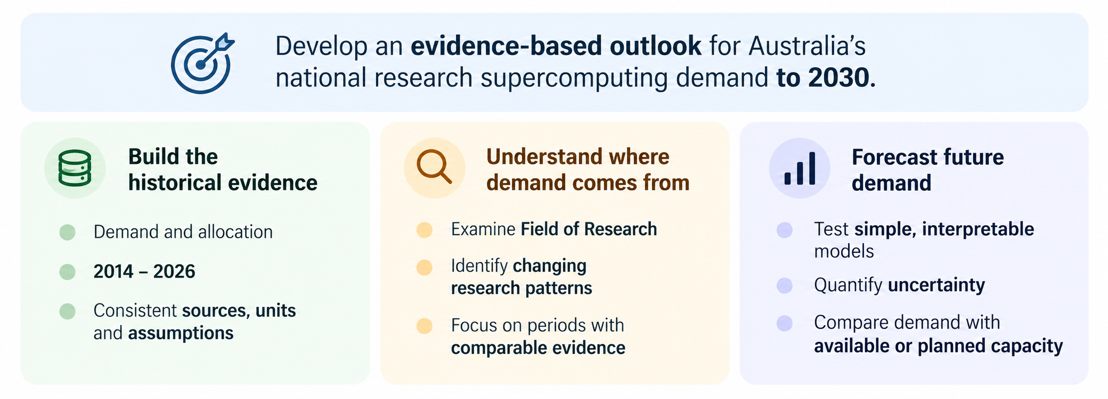
Project Objective

Slide 4
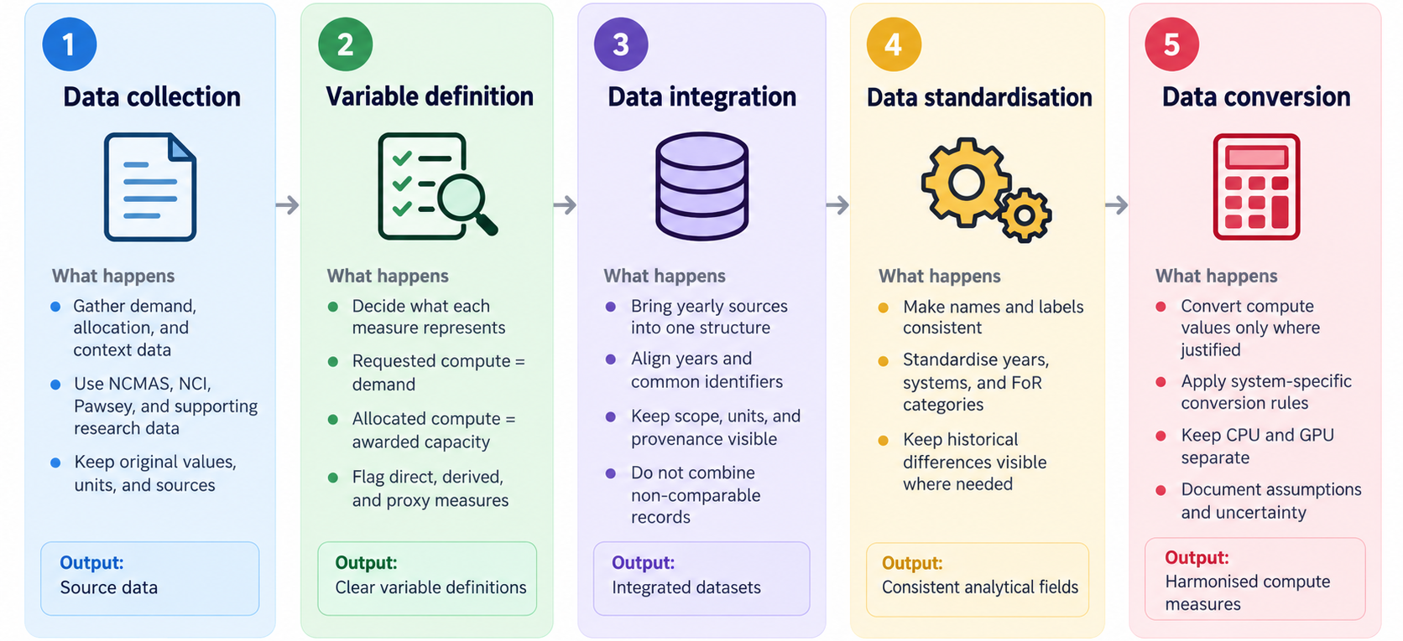
Project METHODOLOGY

Slide 5
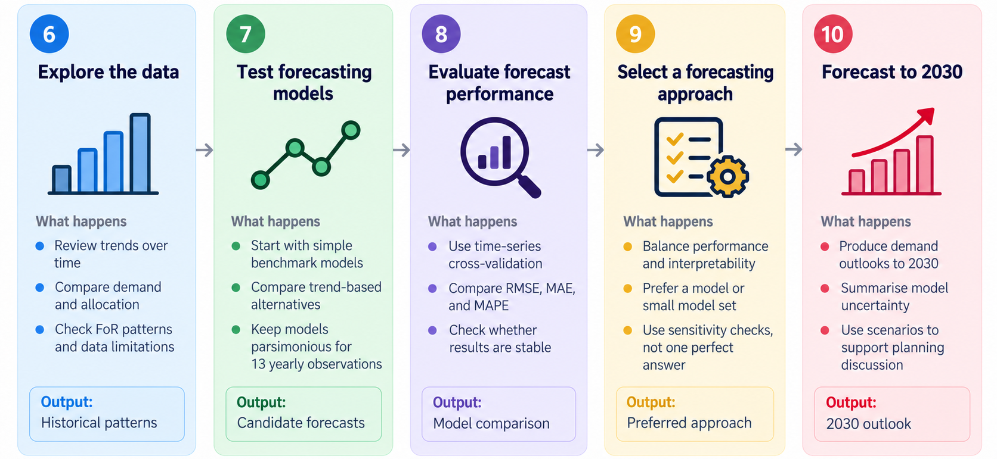
Project METHODOLOGY

Slide 6
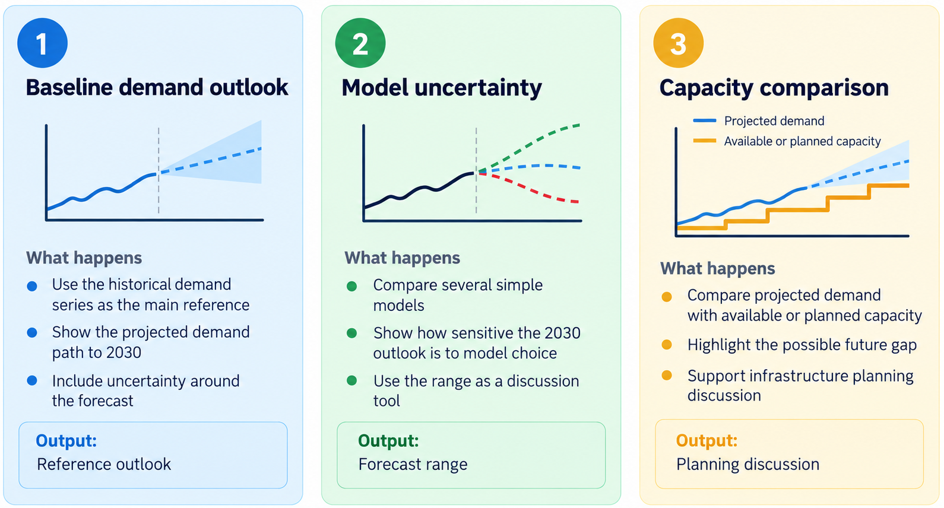
Planned Forecasting Scenarios

Slide 7
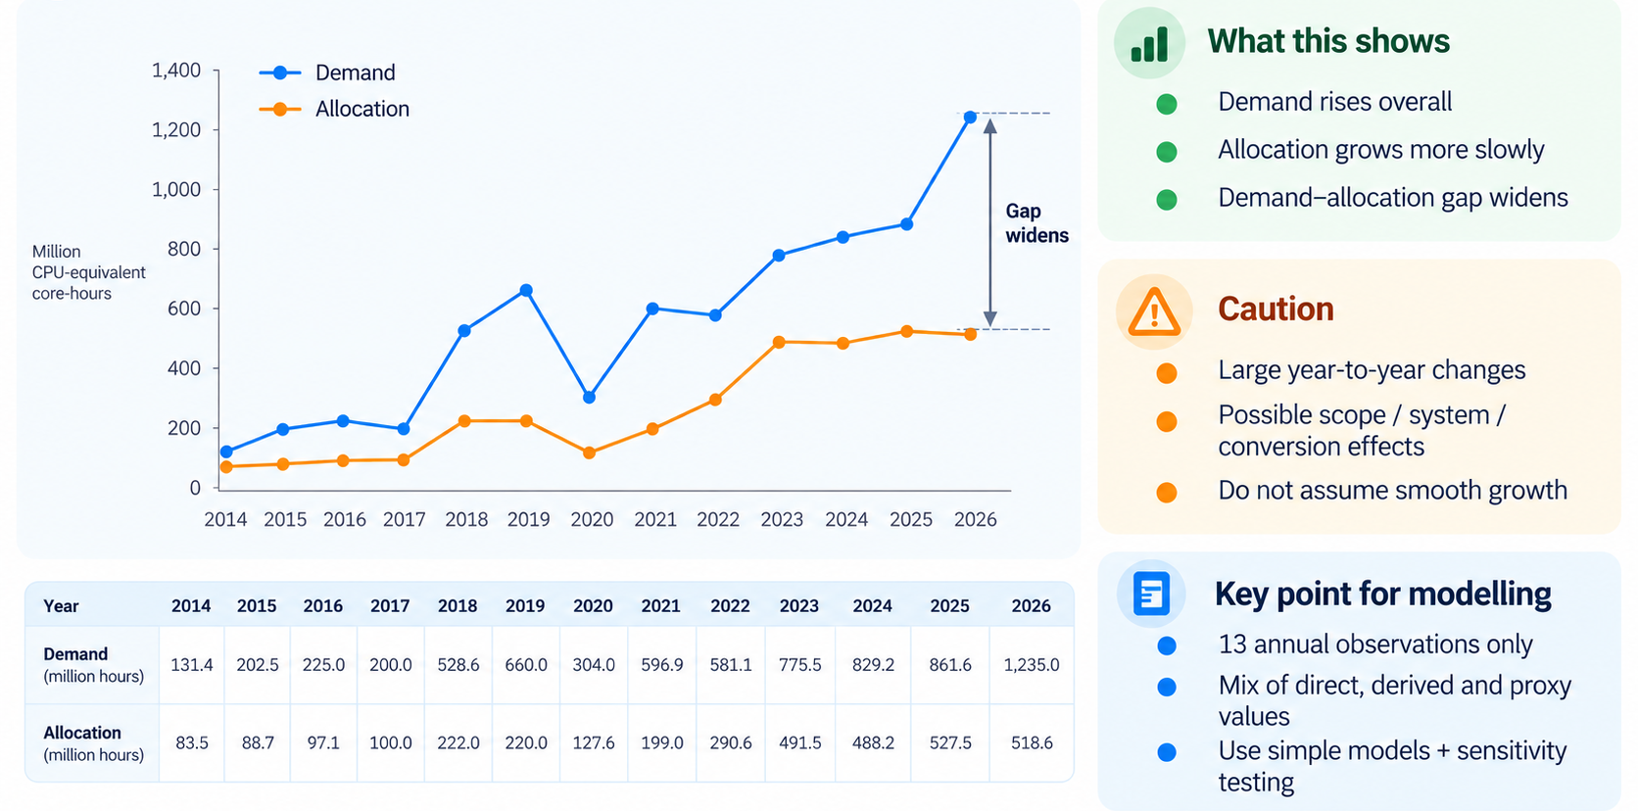
HISTORICAL DEMAND AND ALLOCATION

Slide 8
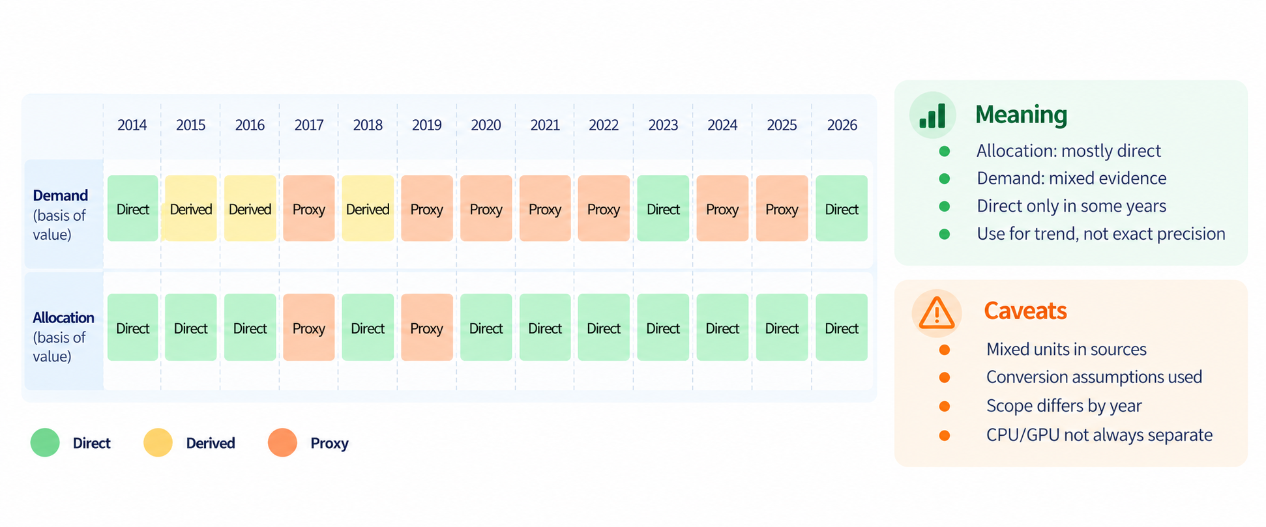
How reliable is the historical series

Slide 9
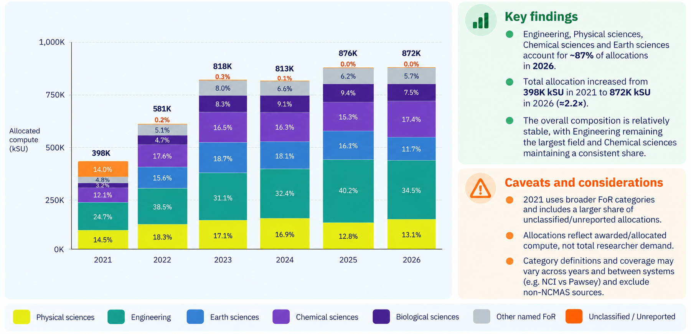
Field of Research (FoR) ANalysis

Slide 10
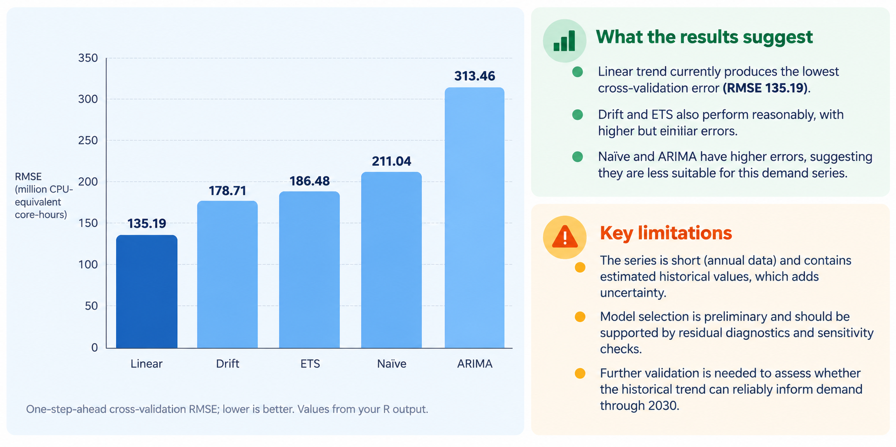
Preliminary model comparison

